Slide 1
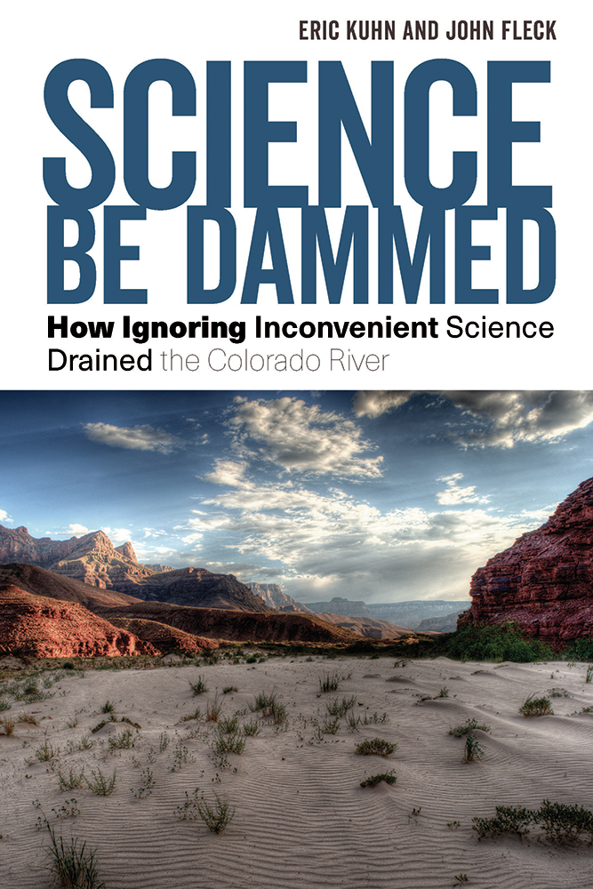
The Millennium Drought (2000-2020) and Its Implications for the Future of the Colorado River
Eric Kuhn
October 14, 2020

Slide 2
The Millennium Drought
Began in 2000
Still with us 21 years later
It’s not the driest 20+ year period in the paleo-record
Science points to temperature as a driver
Could it be the new normal?
Could the future be drier?

Slide 3
Recent Report by the USU Future of the Colorado River Project

Slide 4
ESTIMATED NATURAL FLOWS AT LEES FERRY
2000-2018 12.44 MAF/YEAR (USBR NFDB)
2000-2020 12.5 -12.6 MAF/YEAR (EK estimate)
1953-1977 12.89 MAF/YEAR (USBR NFDB)
1576-1600 11.76 MAF/YEAR (PALEO reconstruction)
1200-1260 12.5-13 MAF/YEAR (PALEO reconstruction)
1906-2018 14.76 MAF/YEAR (“GAUGE” RECORD)
1988-2018 13.16 MAF/YEAR (“STRESS TEST”)

Slide 5
Science is pointing to a simple conclusion –as temperatures go up –Lees Ferry flows go down

Slide 6
IMPLICATIONS
With an average natural flow of 12.5 MAF/yr and an “objective release” of 8.25 MAF/yr @ Lee Ferry – the mathematics is simple, the UB can consume 4.25 MAF/yr (including evap).
4.25 MAF/yr is about what is being consumed today in the UB.
Upper Basin annual consumptive uses have been flat since the late 1980s. Since 2003 Lower Basin mainstem annual consumptive uses have been declining (not including LB tributaries).
NOTE this is based on data published by the USBR that is subject to change and not universally accepted

Slide 8
The basic problem today
How do we squeeze 17.5 million acre-feet of legal apportionments into a 12-13 million acre-foot river?
(And one that may continue to shrink!)

Slide 9
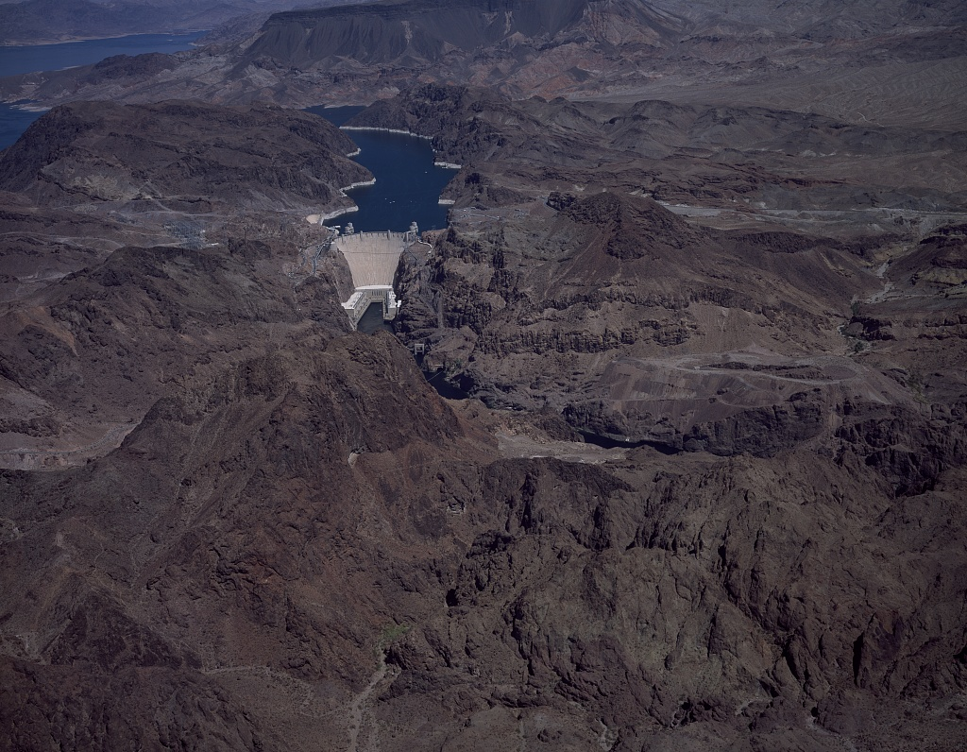
John Fleck
University of New Mexico
Water Resources Program
fleckj@unm.edu
@jfleck
Eric Kuhn
glenwoodrek@gmail.com

Slide 10
The “Law of the River” – allocating water by making rules
1922: Colorado River Compact
1928: Boulder Canyon Project Act
1930-34: Hoover Dam contracts
1944: Treaty with Mexico
1948: Upper Colorado River Compact
1956: Colorado River Storage Project Act
1963: Arizona v. California
1968: Colorado River Basin Project Act

