Slide 1
State Engineer’s Office
Compact Compliance Strategy
Colorado River Basin
Southwest Basin Roundtable; May 13, 2020
Kevin Rein, P.E., State Engineer
Division of Water Resources
March 31, 2020

Slide 2
      “Four Takeaways for Today”
      Understand the SEO’s Compact Compliance Strategy
      What influences Compact Compliance Strategy?
      Current activity of the State Engineer’s Office
      Compact Administration, one scenario

Slide 3
      “Four Takeaways for Today”
      Understand the SEO’s Compact Compliance Strategy
      What influences Compact Compliance Strategy?
      Current activity of the State Engineer’s Office
      Compact Administration, one scenario

Slide 4
      Understand Compact Compliance Strategy
Some Components of the State Engineer’s Efforts on Compact Compliance Strategy
Measurement Rules
Gather Information: Feasibility Studies, Data, Workgroup Strategies
Administer Demand Management Water
Administer Aug Plans, Changes, Other
Develop Compact Administration Rules
Implement Compact Administration
Timeline

Slide 5
      Understand Compact Compliance Strategy
      Why are we talking about a Compact Compliance Strategy instead of Compact Curtailment?
      A discussion about curtailment only: Common assumption
        If and when Colorado is “out of compliance,”
        the State and Division Engineers need only curtail water use according to priority of appropriation,
        Colorado will then again be “in compliance,”
      The actual discussion, and potential course of action is more complex

Slide 6
      Understand Compact Compliance Strategy
      But what does the
      Upper Colorado River Compact say (Article IV)?
      “In the event curtailment…shall become necessary in order that the flow at Lee ferry shall not be depleted below that required by article III of the Colorado river compact…
      “…the extent of curtailment by each state of the consumptive use of water apportioned to it…shall be in such quantities and at such times as shall be determined by the commission…”
      “…the extent of curtailment by each state of the upper division of the consumptive use of water apportioned to it by article III of this compact shall be such as to result in the delivery…”
        Therefore, three considerations: a) “In the event…”; b) “determined by the commission…”; c) “…the extent…by each state…shall be such as to result in the delivery…” (states decide)
        Compact Compliance Strategy addresses a), b), and c).

Slide 7
      Understand Compact Compliance Strategy
      Therefore, the State Engineer’s actions are part of a Compact Compliance Strategy, not Compact Curtailment
      Multi-faceted, holistic approach that addresses a), b), and c),
        What is the strategy before and after the “In the event…” condition is met?
        How does direction from the UCRC influence the strategy?
        How does Colorado’s latitude influence, actually, form the strategy?

Slide 8
      Understand Compact Compliance Strategy
      Consider the South Platte River Compact:
        Flows at Julesburg less than 120 cfs, April 1 – October 15?
        Curtail all diversions in WD 64 junior to June 14, 1897
        Colorado is in compliance
        Colorado does not take any special actions before compliance becomes an issue

Slide 9
      Understand Compact Compliance Strategy
      Consider the La Plata River Compact:
        From February 16 – November 30, determine flows at Hesperus gauge
        If flow at the gauge is less than 100 cfs
        Curtail diversions (in priority) to ensure delivery of one half that amount at the state line on the following day
        Colorado is in compliance
        Colorado does not take any special actions before compliance becomes an issue

Slide 10
      Understand Compact Compliance Strategy
      Consider the Colorado River Compact:
        The states of the Upper Division will not cause the flow of the river at Lee Ferry to be depleted below an aggregate of 75,000,000 acre-feet for any period of ten consecutive years…
        That is the recognized (Upper Basin States’) standard for maintaining compact compliance,
        What is compliance? How do we maintain it?

Slide 11
      Understand Compact Compliance Strategy
Some Components of the State Engineer’s Efforts on Compact Compliance Strategy
Measurement Rules
Gather Information: Feasibility Studies, Data, Workgroup Strategies
Administer Demand Management Water
Administer Aug Plans, Changes, Other
Develop Compact Administration Rules
Implement Compact Administration
Timeline

Slide 12
      Understand Compact Compliance Strategy
Measurement Rules
Gather Information: Feasibility Studies, Data, Workgroup Strategies
Administer Demand Management Water
Administer Aug Plans, Changes, Other
Develop Compact Administration Rules
Implement Compact Administration

Slide 13
      Understand Compact Compliance Strategy
Compact Compliance Strategy
Timeline

Slide 14
      “Four Takeaways for Today”
      Understand the SEO’s Compact Compliance Strategy
      What influences Compact Compliance Strategy?
      Current activity of the State Engineer’s Office
      Compact Administration, one scenario

Slide 15
      What Influences Compact Compliance Strategy?
      What influences Compact Compliance Strategy?
        Probability that based on UCRC determination, Colorado would need to take action and implement Compact Administration,
        Upper Colorado River Compact; UCRC role,
        Develop an approach,
        Implement Compact Administration as a part of Compact Compliance Strategy.

Slide 16
      What Influences Compact Compliance Strategy?
      What influences Compact Compliance Strategy?
        Probability that based on UCRC determination, Colorado would need to take action and implement Compact Administration,
        Upper Colorado River Compact; UCRC role,
        Develop an approach,
        Implement Compact Administration as a part of Compact Compliance Strategy.

Slide 17
      What Influences Compact Compliance Strategy?
      Probability of need to take action and implement Compact Administration
        Currently (2018) the Upper Basin States’ delivery stands at 92,124,000 acre-feet,

Slide 18
      Probability of need to take action, Compact Administration

Slide 19
      Probability of need to take action, Compact Administration

Slide 20
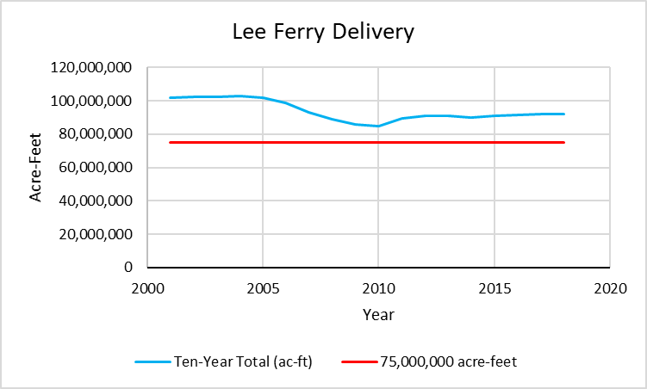
      Probability of need to take action, Compact Administration

Slide 21
      Probability of need to take action, Compact Administration
2017-2018 Actual Totals
2019-2021; Current projection, November 2019 24-Month Study*
2022-2025; Minimum release under ’07 Guidelines = 7,000,000 acre-feet*
Acknowledge Mexico “obligation”
Consider 150,000 ac-ft gain in river, Powell to Lee Ferry

Slide 22
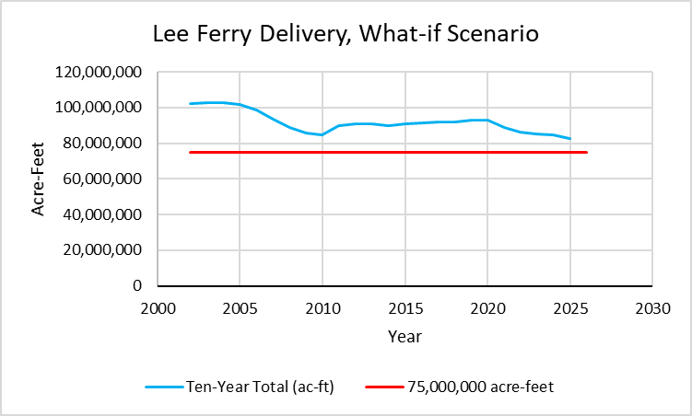
      Probability of need to take action, Compact Administration

Slide 23
      Probability of need to take action,
      Compact Administration
      Probability of need to take action and implement Compact Administration;
        Currently (2018) the Upper Basin State’s delivery stands at 92,124,000 acre-feet,
        The reservoir operations direct deliveries at least in amounts that exceed the “What-if Scenario.”
        Low probability between now and 2026

Slide 24
      What Influences Compact Compliance Strategy?
      What influences Compact Compliance Strategy?
        Probability that based on UCRC determination, Colorado would need to take action and implement Compact Administration,
        Upper Colorado River Compact; UCRC role,
        Develop an approach,
        Implement Compact Administration as a part of Compact Compliance Strategy.

Slide 25
      What Influences Compact Compliance Strategy?
      Upper Colorado River Compact; UCRC Role;
        The need for curtailment is determined by the Upper Colorado River Commission, which includes Colorado’s Commissioner, due to imminent need,
        Colorado actions limited by Upper Colorado River Compact.

Slide 26
      What Influences Compact Compliance Strategy?
      What influences Compact Compliance Strategy?
        Probability that based on UCRC determination, Colorado would need to take action and implement Compact Administration,
        Upper Colorado River Compact; UCRC role,
        Develop an approach,
        Implement Compact Administration as a part of Compact Compliance Strategy.

Slide 27
      What Influences Compact Compliance Strategy?
      Develop an approach;
        Priority administration?
        Acquire relevant information, data, rules?

Slide 28
      What Influences Compact Compliance Strategy?
      Develop an approach;
        Simple priority administration may not be enough. Why?
        Use available information, data, rules?

Slide 29
      What Influences Compact Compliance Strategy?
      Develop an approach
        Simple priority administration? Can we do more?
        Use available information, data, rules?
          Informed, contemplated, more precise,
          Stakeholder involvement,
          Allows for planning, develop options,
          Acknowledge legal concerns.

Slide 30
      What Influences Compact Compliance Strategy?
      Use available information, data, rules?
        Compact Compliance Study,
        Renegotiation of ’07 Guidelines,
        Data (Measurement Rules),
        Demand Management (consider the outcome of the workgroups),
        Compact Administration Rules.

Slide 31
      What Influences Compact Compliance Strategy?
      Use available information, data, rules?
        Compact Compliance Study,
        Renegotiation of ’07 Guidelines,
        Data (Measurement Rules),
        Demand Management (consider the outcome of the workgroups),
        Compact Administration Rules.

Slide 32
      What Influences Compact Compliance Strategy?
      Why Measurement Rules?
        Consider administration in other basins,
        Data is critical; accuracy is critical,
        Consider as an important first step,
        What would Measurement Rules entail?

Slide 33
      What Influences Compact Compliance Strategy?
      Components of Measurement Rules
        Statutory Authority (section 37-84-112, C.R.S.)
        Objective, Scope, Applicability,
        Definitions
        Measurement Methods, Functional Standards
        Reporting
        Enforcement

Slide 34
      Components of Measurement Rules
      Statutory Authority (section 37-84-112, C.R.S.)
        “(1) The owners of any irrigation ditch, canal, flume, or reservoir in this state, taking water from any stream, shall erect where necessary and maintain in good repair, at the point of intake of such ditch, canal, flume, or reservoir, a suitable and proper headgate of height and strength and with embankments sufficient to control the water at all ordinary stages and suitable and proper measuring flumes, weirs, and devices and shall also erect and maintain in good repair suitable wastegates where necessary in connection with such ditch, canal, flume, or reservoir intake.”
        Understand “…where necessary…”

Slide 35
      Components of Measurement Rules
      Objective, Scope, Applicability
        Objective:
          Basins with increasing demand, over-appropriation, need for administration
          Augmentation plans, need for verification of operation
          Data to plan for and implement Compact Compliance Administration
        Scope and Applicability
          Surface water, groundwater
          Colorado River Basin? Statewide?

Slide 36
      Components of Measurement Rules
      Measurement Methods, Functional Standards
        Surface water
          Flumes, weirs, current meters, radar, alternative
        Groundwater
          Totalizing Flow Meter, Power Consumption Coefficient?
        Accuracy and verification standards
        Consider geography, source, administrative need

Slide 37
      Components of Measurement Rules
      Reporting and Enforcement
        Frequency of measurement and reporting, types of information,
          Administration-based, by decree, Compact administration requirements
        Enforcement
          Ensure compliance
          Consider geography, source, administrative need

Slide 38
      Components of Measurement Rules
      Going forward (one plan, dependent on the ability to travel and gather)
        Informal outreach by State Engineer’s Office
          Spring, Summer 2020
        Informal stakeholder, gathering information and input
          Late 2020 (How to reach people?)
        Initiate Rulemaking
          2021
          Formal stakeholder meetings
          Draft Rules
          Initiate formal rulemaking; SEO authority? APA?

Slide 39
      What Influences Compact Compliance Strategy?
      Use available information, data, rules?
        Compact Compliance Study,
        Renegotiation of ’07 Guidelines,
        Data (Measurement Rules),
        Demand Management (consider the outcome of the workgroups),
        Compact Administration Rules.

Slide 40
      What Influences Compact Compliance Strategy?
      What could Compact Administration Rules look like?
        Guide the State Engineer in Compact Administration
          Define process
          Acknowledge UCRC and its role, interaction with UCRC
          Monitoring methodology
          Guidance on strict application of priority
          Guidance on enforcement
          Consider “Present Perfected Rights,” how that influences administration
          Mechanisms for allowing diversion by water rights that would otherwise be curtailed

Slide 41
      What Influences Compact Compliance Strategy?
      What influences Compact Compliance Strategy?
        Probability that based on UCRC determination, Colorado would need to take action and implement Compact Administration,
        Upper Colorado River Compact; UCRC role,
        Develop an approach,
        Implement Compact Administration as a part of Compact Compliance Strategy.

Slide 42
      What Influences Compact Compliance Strategy?
      Implement Compact Administration;
        Certain direction from UCRC,
        Reliable data is available,
        Certain process if Compact Administration Rules are developed,
        Precise, focus to maintain compliance while avoiding over-delivery.

Slide 43
      “Four Takeaways for Today”
      Understand the SEO’s Compact Compliance Strategy
      What influences Compact Compliance Strategy?
      Current activity of the State Engineer’s Office
      Compact Administration, one scenario

Slide 44
      Current Activity of the State Engineer’s Office
      The need for Compact Administration is not imminent
      Then why all this activity right now?

Slide 45
      Current Activity of the State Engineer’s Office
      Then why all this activity right now?
        Drought Contingency Plan; why?
        Demand management; why?
        Measurement Rules, why?
        Compact Administration; why not?
          A final plan for Compact Administration now is not helpful
            Not needed now, too much information is pending
          However, understanding the scope of a Compact Compliance Strategy now is important to other activities

Slide 46
      Current Activity of the State Engineer’s Office
      The need for Compact Administration is not imminent
      We will continue to get more guidance and information; helpful and necessary to Compact Administration
      Begin with Basin Measurement Rules, upcoming outreach
      Refine our understanding:
        Coordination with CWCB and UCRC
        Scope of a Compact Compliance Strategy
        Available Tools
        Investigate and Plan: Scope and Process for Rulemaking; Structure of Rules
      Incorporate this information into a Compact Compliance Strategy; communicate with Colorado stakeholders

Slide 47
      “Four Takeaways for Today”
      Understand the SEO’s Compact Compliance Strategy
      What influences Compact Compliance Strategy?
      Current activity of the State Engineer’s Office
      Compact Administration, one scenario

Slide 48
      Compact Administration, a Scenario
      Upper Colorado River Commission determination
        “Curtailment” is necessary to maintain compliance
        Colorado is informed of its obligation, time and amount
      State Engineer’s Office implements Compact Administration,
        Potential guidance from Compact Administration Rules
        Status of CRSPA Reservoirs influences administration
        Present perfected rights influences the administration
        Rules provide for consideration of priority
        Potential availability of Demand Management water
        Rules provide for other mechanisms
        Administration is guided by the outcome of studies of water use
      Result is precise, informed, legally sound administration (which may include curtailment) that is targeted toward compliance while avoiding over-delivery

